Slide 1
ELIXIR
Bioschemas for beacons discovery
Rafael C Jimenez, ELIXIR CTO
March 22, 2017
Human data session

Slide 2
TOC
SOA
Metadata registration
Bioschemas
Bioschemas for Beacon discovery
Bioschemas beacon mockup
Registry ideas
A list in GitHub
DNS
Peer to Peer

Slide 3
SOA Service Oriented Architecture

Slide 4
Service Oriented Architecture
Software design methodology
Defines a federated environment
Contributes to standardization and modularization
Broker
Find
Publish
Contract
Consumer
Providers
Query

Slide 5
Service Oriented Architecture
Software design methodology
Defines a federated environment
Contributes to standardization and modularization
Registry
Broker
Find
Publish
Standard
Contract
Consumer
Providers
Client
Query
Servers

Slide 6
SOA design principles
Standardized service contract
Service
Loose coupling
Abstraction
Reusability
Autonomy
Statelessness
Discoverability
Composability

Slide 7
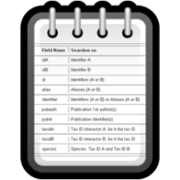

Molecular interactions via PSICQUIC
Registry
Find
Publish
Standard
MIQL
Query
PSICQUIC
Service A
PSICQUIC
Service B
PSICQUIC
Service C
Client
Servers

Slide 8

Beacons
Registry
Find
Publish
Standard
Beacons spec
Query
BEACON
Service A
BEACON
Service B
BEACON
Service C
Client
Servers

Slide 9
Current Beacons and Beacon Network
Registry
Publish
BEACON
Service A
+
Find
BEACON
Service B
Standard
Beacons spec
BEACON
Service C
Client
Query
Servers

Slide 10
Metadata registration

Slide 11
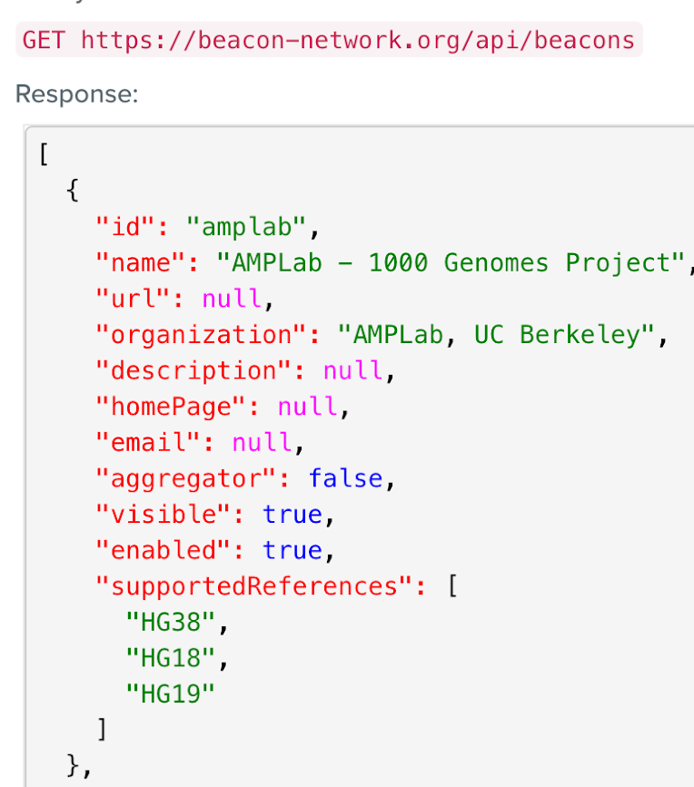
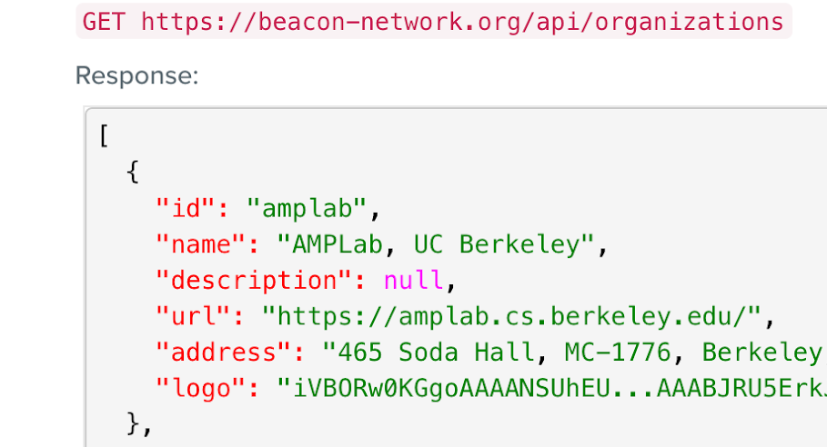
Beacon service metadata
Beacon
Organisation
Version
Capabilities
Last update
…
https://beacon-network.org/#/developers/api/beacon-network

Slide 12
Push
Service metadata
BEACON
Service A
Publish
Server
Registry
Metadata registration/update on the server side
Relies normally on one registry

Slide 13
Pull
URL
Publish
BEACON
Service A
Server
Registry
Service metadata
Responsibility on the registry side
Several registries are possible

Slide 14
Registries - complexity
Minimum
Comprehensive
List of ULRs
List of ULRs
Metadata
Search/Filtering
Validation
Monitoring
…

Slide 15
Registries - complexity
Minimum
Comprehensive
OR / AND
List of ULRs
List of ULRs
Metadata
Search/Filtering
Validation
Monitoring
…

Slide 16
Beacons
Registry
Service metadata
Find
Publish
Standard
ULR
Beacons spec
Query
BEACON
Service A
BEACON
Service B
BEACON
Service C
Client
Servers

Slide 17
Bioschemas

Slide 18

<div>
<h1>Classic potato salad</h1>
<div>
Nutrition facts:
<span>144 kcal</span>,
</div>
Ingredients:
- <span>800g small new potato</span>
- <span>3 shallot</span>
. . .

Slide 19
<div>
<h1>Classic potato salad</h1>
<div>
Nutrition facts:
<span>144 kcal</span>,
</div>
Ingredients:
- <span>800g small new potato</span>
- <span>3 shallot</span>
. . .
Recipe
Title
Nutrition
Calories
Ingridients

Slide 20


Structured data markup for web pages
RDFa
JSON-LD
Microdata
With markup
<div itemscope itemtype="http://schema.org/Recipe">
<h1 itemprop="name">Classic potato salad</h1>
<div itemprop="nutrition” itemscope
itemtype="http://schema.org/NutritionInformation">
Nutrition facts:
<span itemprop="calories">144 kcal</span>,
</div>
Ingredients:
- <span itemprop="recipeIngredient">800g small new potato</span>
- <span itemprop="recipeIngredient">3 shallot</span>
. . .

Slide 21
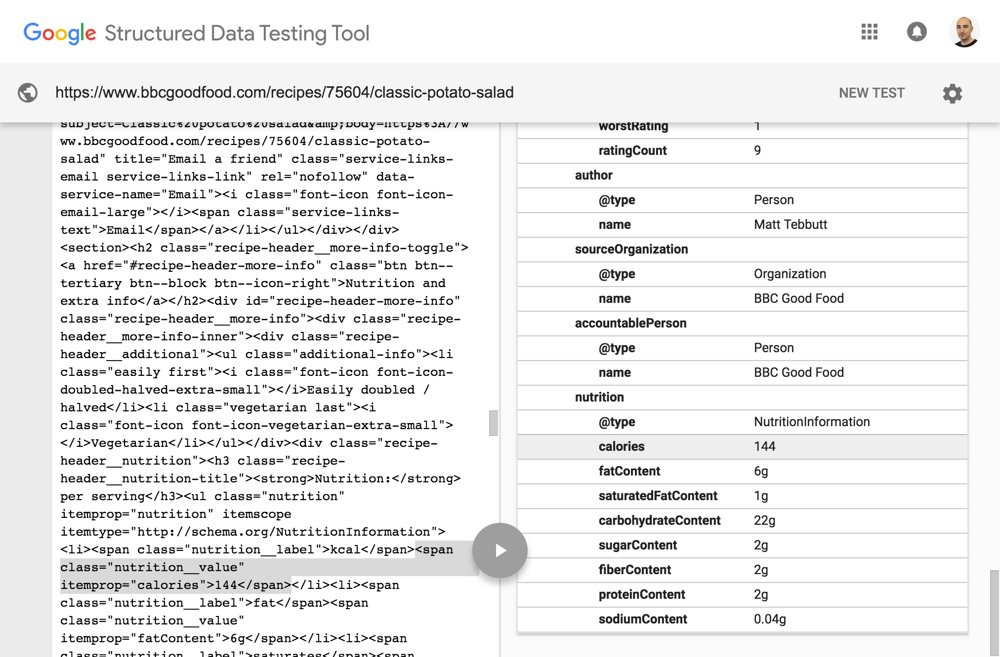
Structured data markup for web pages

Slide 22
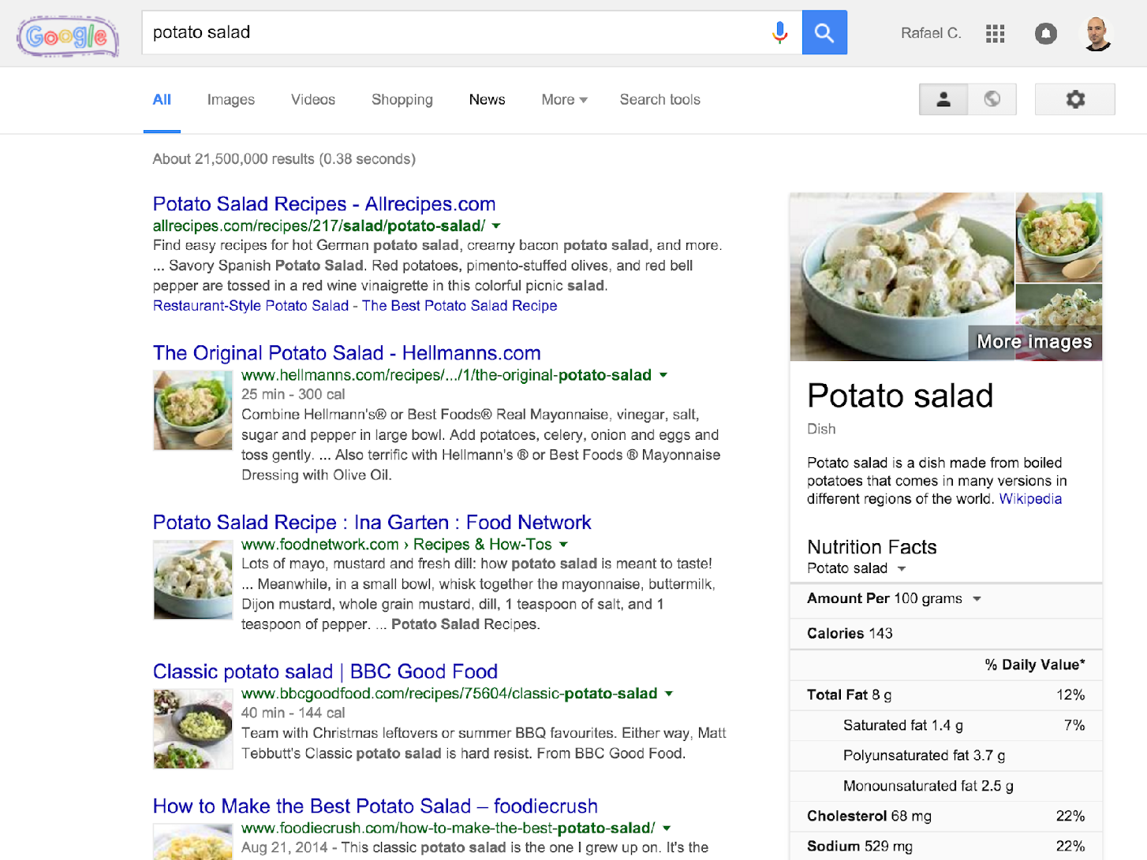

Slide 23
Bioschemas
Schema.org for biological related information
Minimum properties for finding data

Slide 24
BioSchemas
Specification on top of schema.org
Layer of constrains + documentation + extensions
Specification
Data model
Minimum information
Controlled vocabularies
Cardinality
New (properties | types)
Documentation
Examples

Slide 25
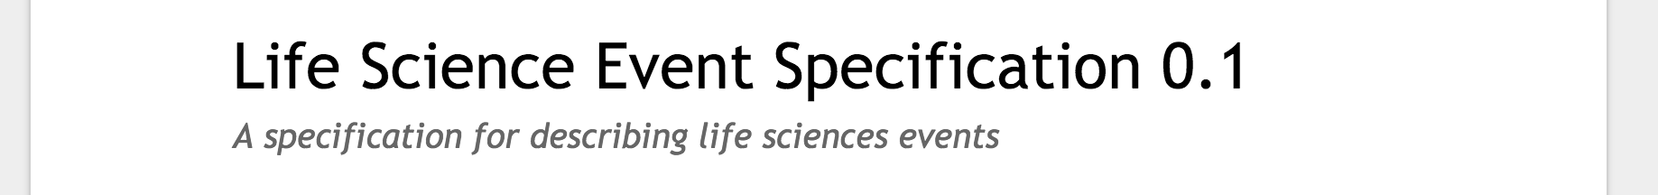
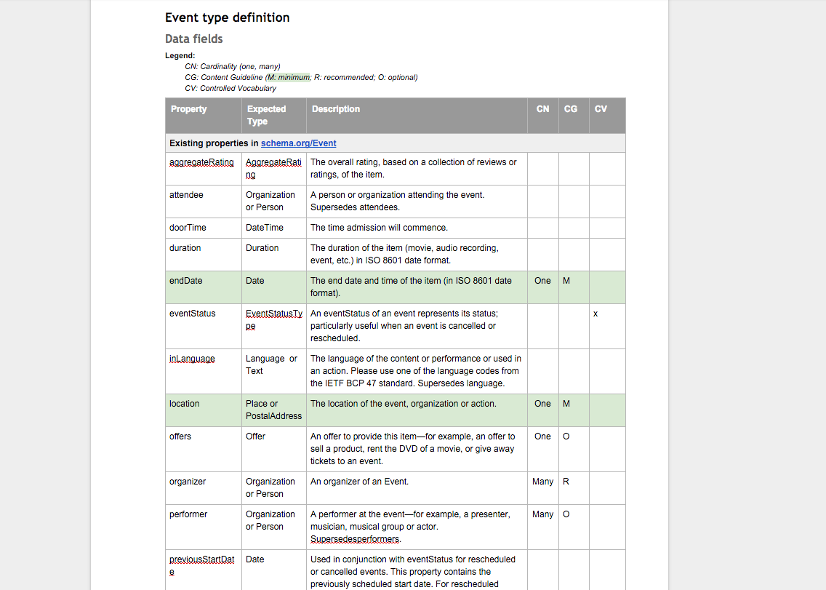
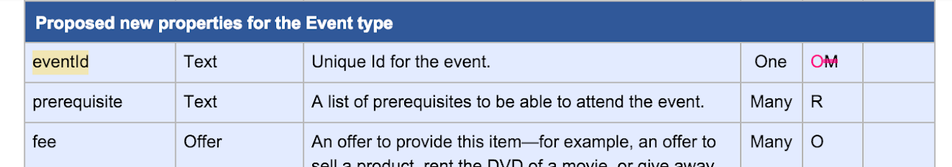
Data model
Minimum information
Controlled vocabularies
Cardinality
New properties

Slide 26


Access to structured data in web pages via Bioschemas
Data
repository
Data
repository
Data
repository
Bioschemas
Bioschemas
Bioschemas
Registry
Search engine
Search engines favour websites containing schema.org in their search results

Slide 27
Access to structured data in web pages via Bioschemas
EMBL-EBI
GOBLET
ELIXIR Hub
Data
repository
Data
repository
Data
repository
Bioschemas
Bioschemas
Bioschemas
Registry
Search engine
TeSS
Google, Yahoo, Bing, Yandex, …
Training materials & Events

Slide 28
Access to structured data in web pages via Bioschemas
EMBL-EBI
SIB
SCS
Data
repository
Data
repository
Data
repository
Bioschemas
Bioschemas
Bioschemas
Registry
Search engine
Bio.tools
Google, Yahoo, Bing, Yandex, …
Tools

Slide 29
Access to structured data
EGA
Gene3D
Beacons
HPA
PDBe
Brassica IP
UniProt
COPaKB
Pfam
BBMRI-NL Biobank
BRENDA
…
Data
repository
Data
repository
Data
repository
Bioschemas
Bioschemas
Bioschemas
Beacon network
Biosharing
Registry
Search engine
Biosamples
Bio.tools
UKCRC TC
DataMed
Google, Yahoo, Bing, Yandex, …
Biocatalogue
Identifiers.org
…
Samples, Phenotypes, Datasets, Beacons, Protein annotations, Data repositories, …

Slide 30
Bioschemas for Beacon discovery

Slide 31
Bioschemas beacon project
Problem
At the moment the registration of a Beacon service in the Beacon Registry is done manually and needs to be updated manually if the beacon service changes
Objectives
Expose Beacon service metadata in its default home page with Bioschemas
Automate the ingestion of the beacon service metadata into a beacon registry

Slide 32


Registry updated via schema.org
API
Genomics data
Client
BEACON
Service A
Server
Web page
Service metadata
Registry

Slide 33
Why Schema.org for beacons
Good practice to describe structured data for web pages
More discoverable by search engines (boost SEO)
Automate metadata collection into registries
Not just for for machines but also humans
Generic enough
Applicable to different genomics end points
Applicable to different versions
Simple adoption, simple to update
Keep API as simple as possible

Slide 34

Bioschemas Beacons Mockup https://github.com/BioSchemas/bioschemas-beacons-mockup
Guillermo J Calderón

Slide 35
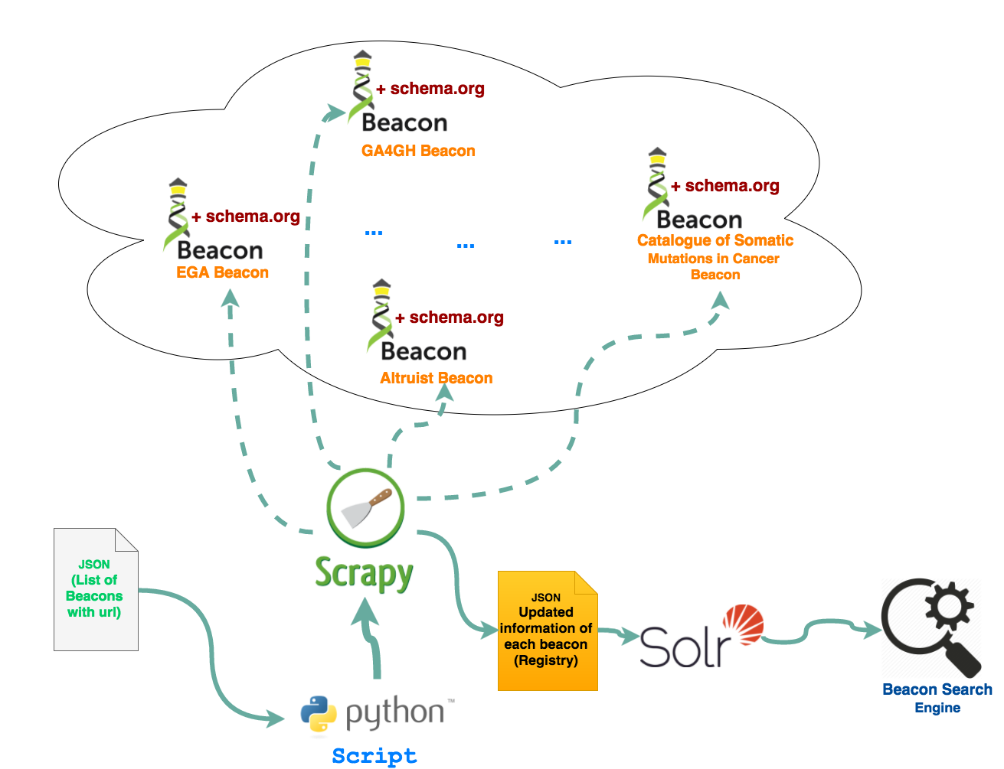

Slide 36
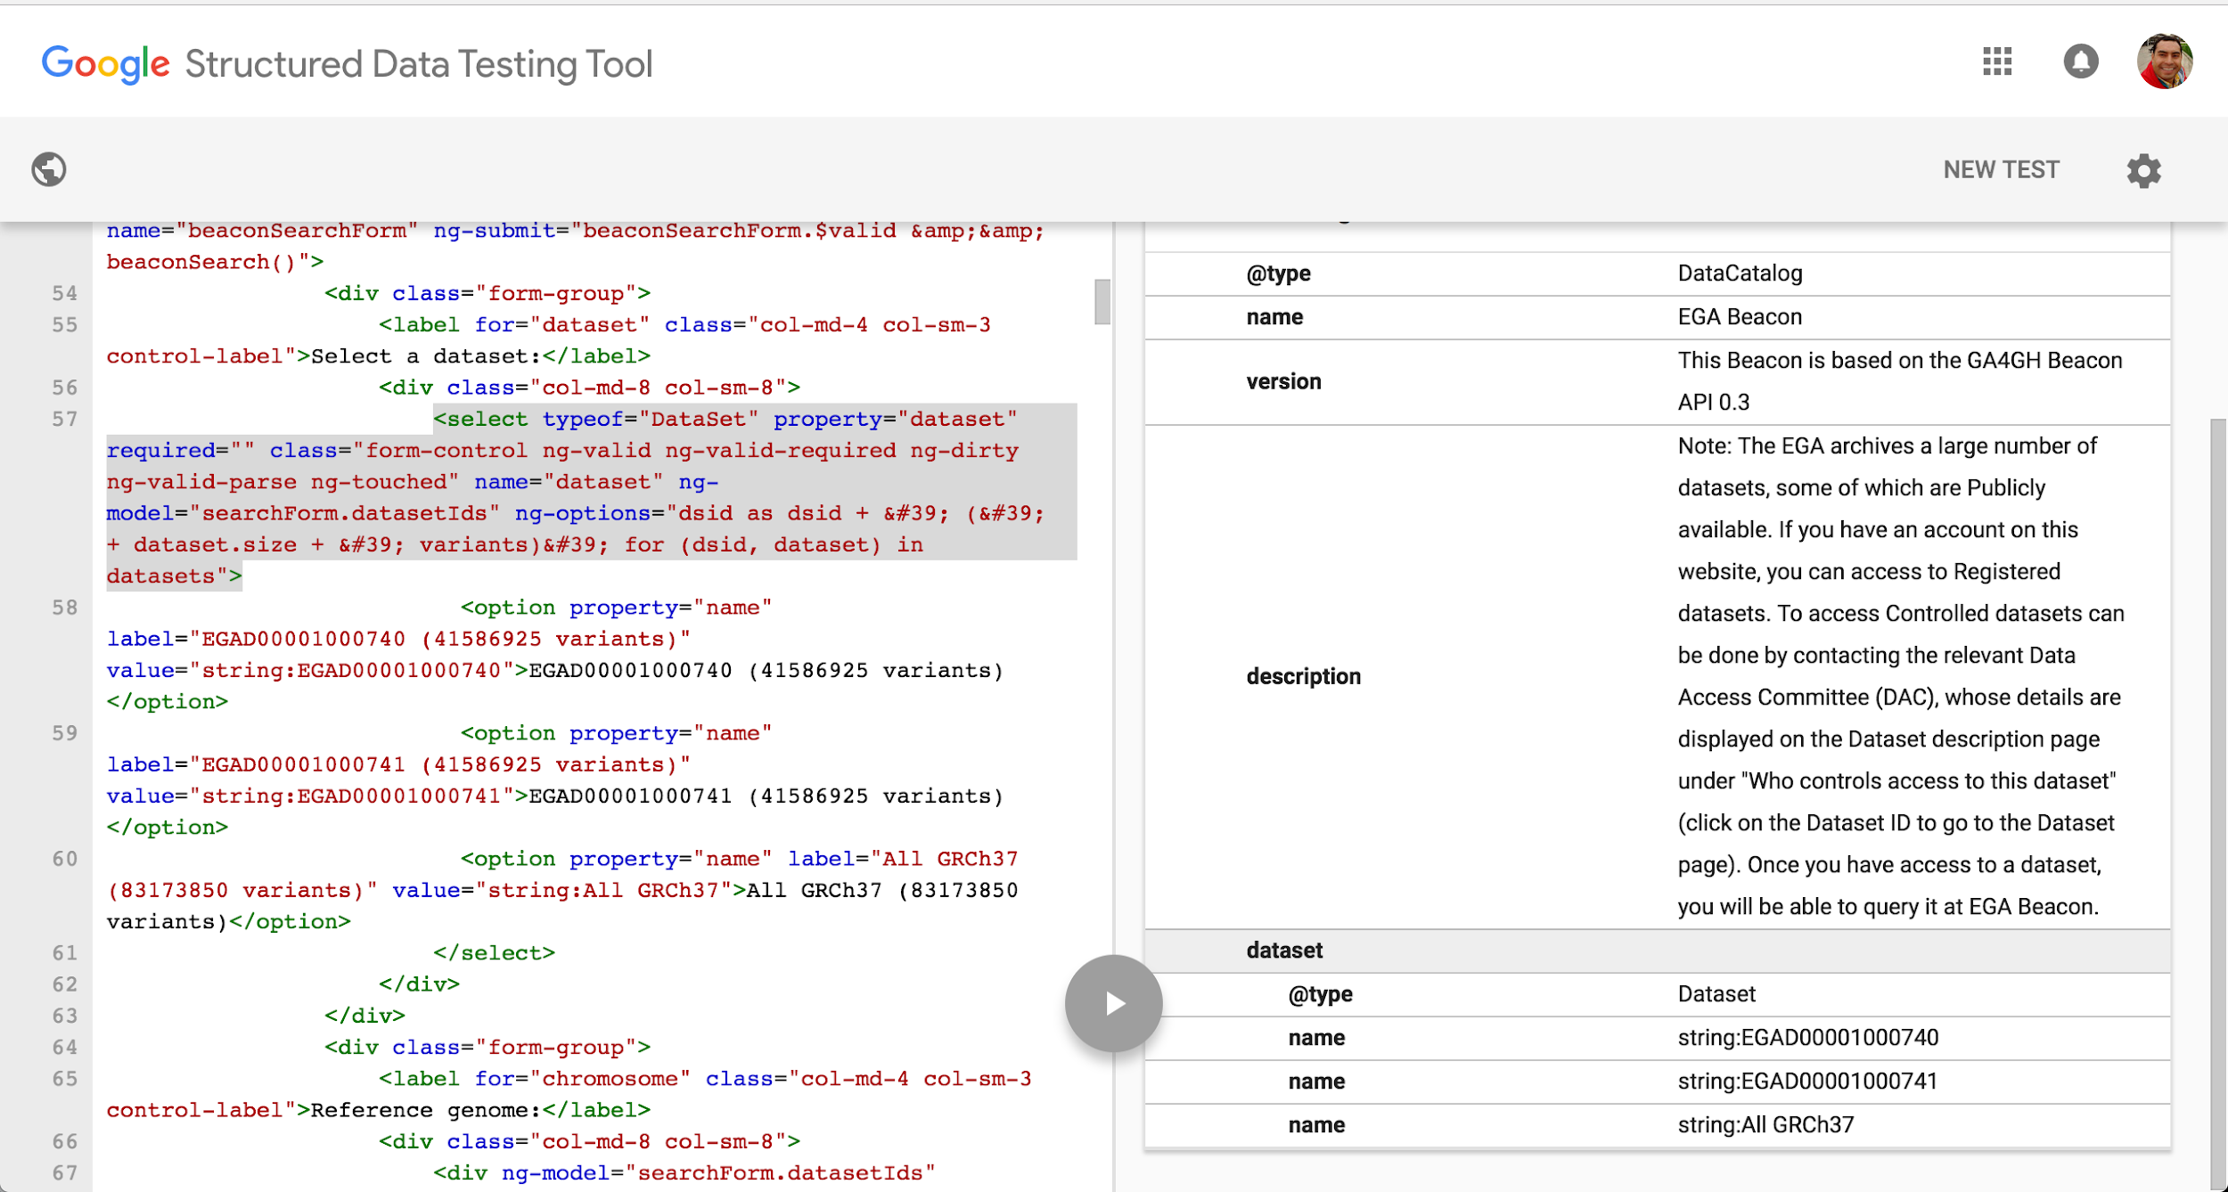
Beacon with schema.org markup

Slide 37
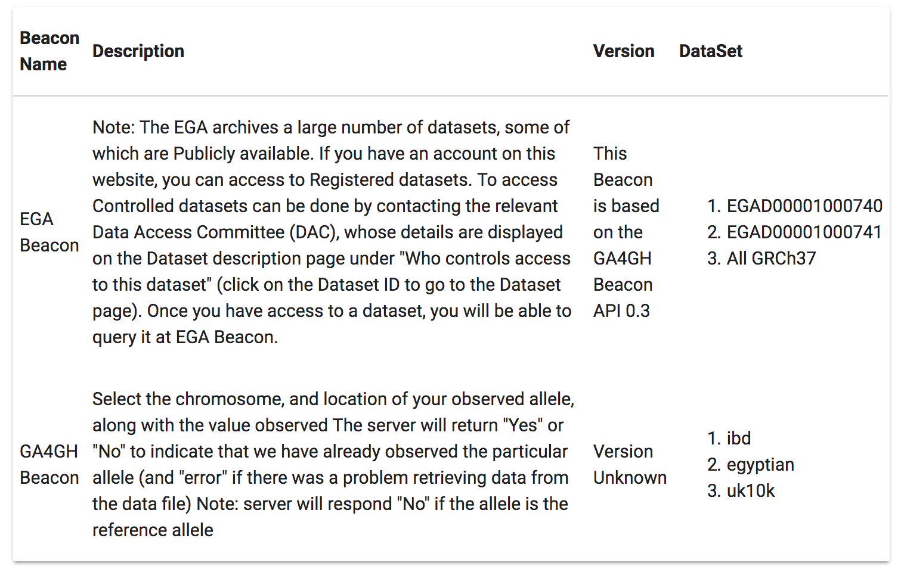

Metadata integration
https://github.com/BioSchemas/bioschemas-beacons-mockup

Slide 38
Registry ideas

Slide 39
Background – Beacons registry proposal
The “Beacon Network” (beacon-network.org) is both a registry (i.e. a list of Beacons) and a search engine (i.e. a way to search all of them)
It would be useful to have a registry of Beacons maintained by the Beacon Project that other organizations can use to build new applications on
we hope that the availability of the registry inspires new ideas for new applications, not just search (e.g. federated allele frequencies)
https://docs.google.com/document/d/1SmB9ppa1NVM0OwDp_gKGFO2TdFQQgxoN4ZMhMPNPZLw/edit?usp=sharing

Slide 40
Proposed properties
generalizes to other GA4GH services
decentralized
crawlable
open: while there may be multiple registries, a beacon provider should always be able to add any Beacon to the GA4GH registry
protected namespaces
private registries / subnetworks
multiple subnets (e.g. ELIXIR) with membership rules?
list of beacons with URLs and security information for the purpose of discovery
supports manually curated registries - control over members (ELIXIR use case)
supports dynamic registries, i.e. programmatic sign-up (public Beacon Network use case)
available soon (ELIXIR timelines and deliverables building on top of it)
tag-based filtering/grouping
monitoring - announcing healthy beacons, potential attacks etc.

Slide 41
Proposed technologies
a list in Github
DNS / SSL model
peering
blockchain
Bitcoin
IPNS/IPFS (with link to DNS via TXT)

Slide 42
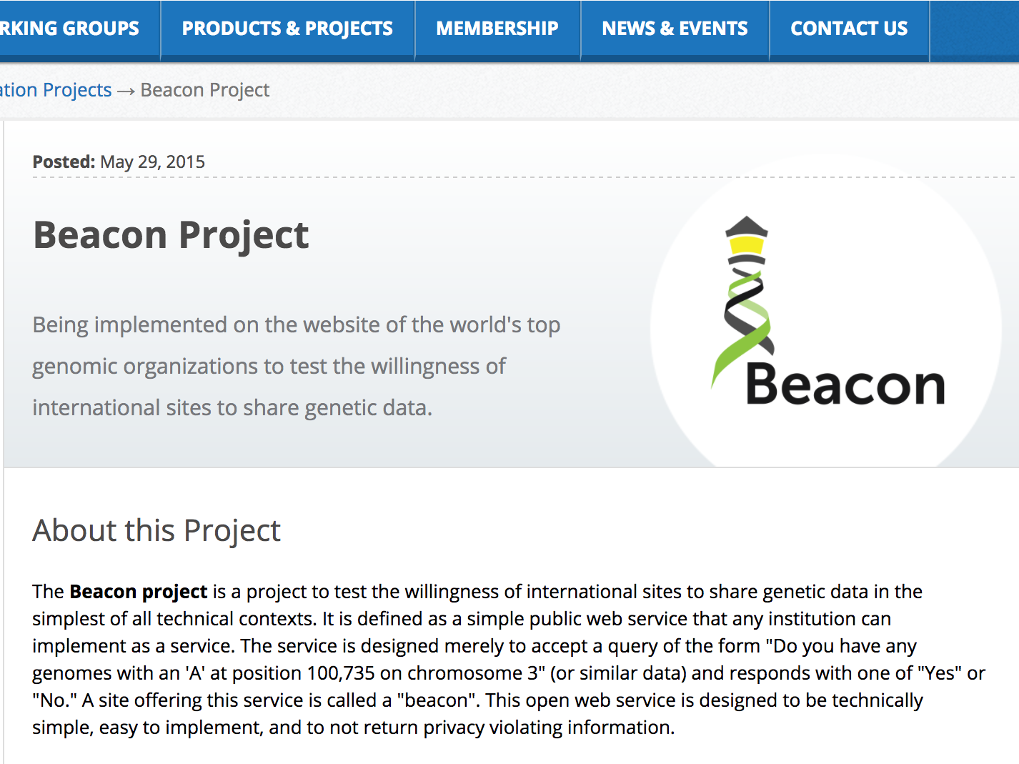

Slide 43
A list in GitHub

Slide 44

Registry as list in GitHub
Minimum
Comprehensive
List of ULRs
List of ULRs
Metadata
Search/Filtering
Validation
Monitoring
…

Slide 45
Registry as list in GitHub
Includes authentication
Permission to facilitate moderation
Anybody can make changes via pull requests
Record of changes (versioning)
Easy to comment and provide feedback
Does not need to be GitHub
Could be more than one list

Slide 46
DNS

Slide 47
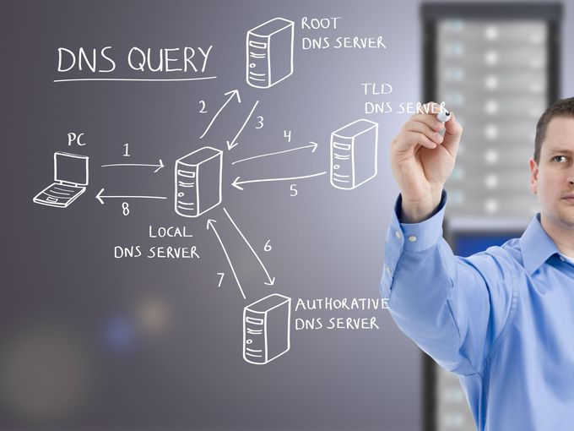
DNS

Slide 48
Peer to Peer

Slide 49
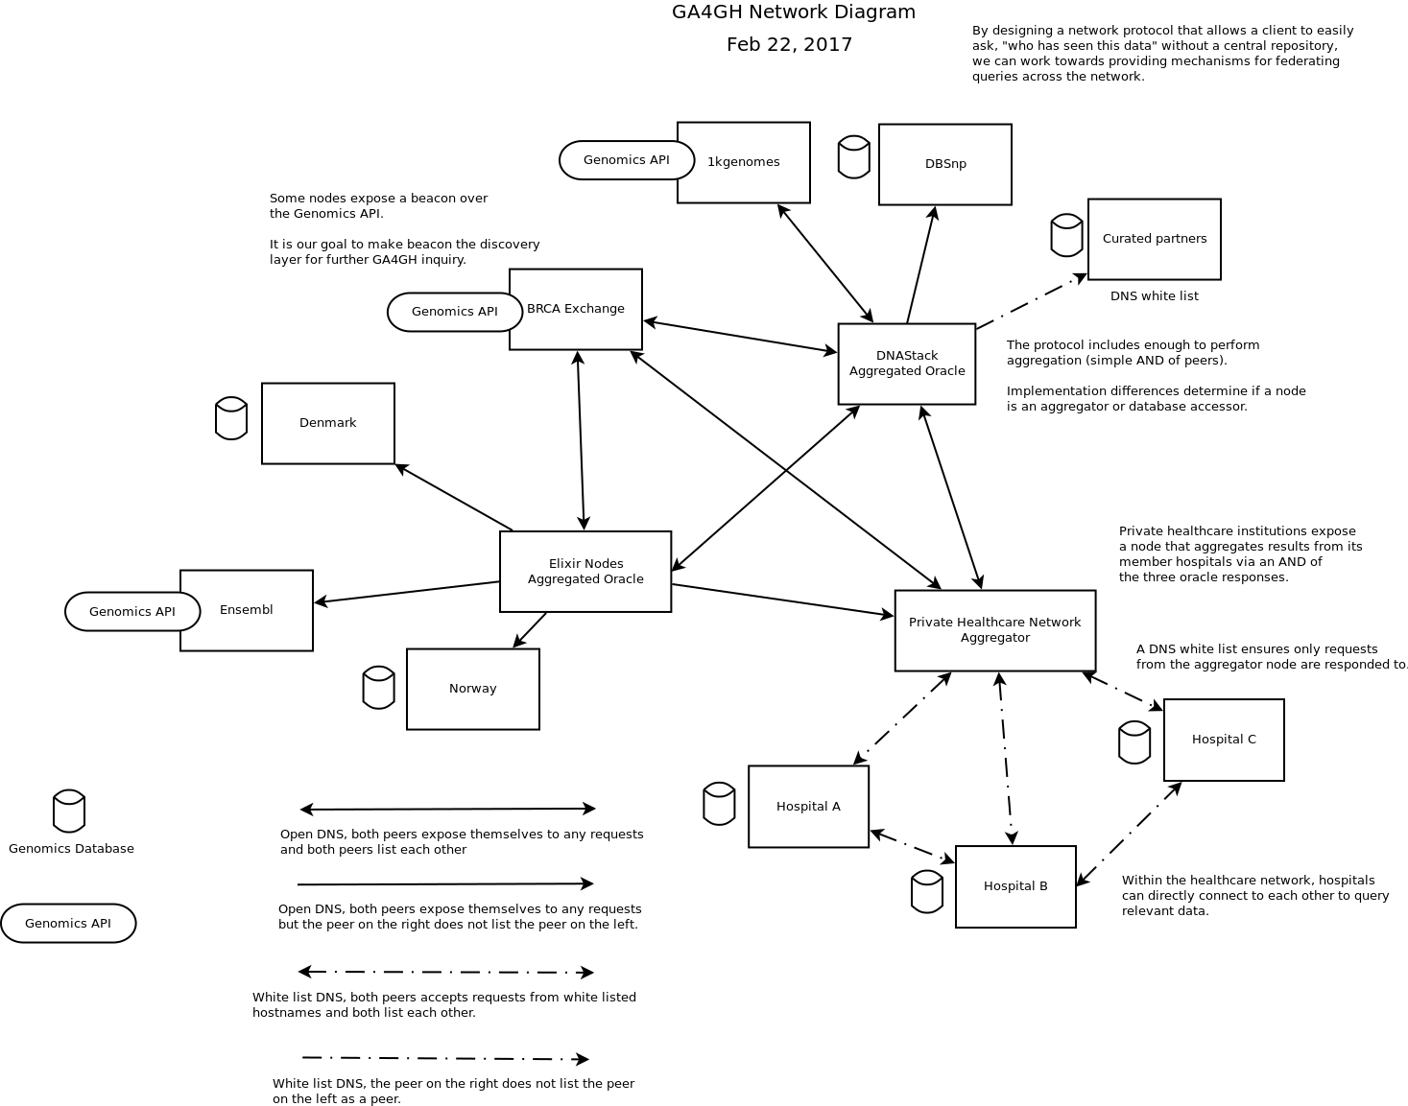
Proposal - Peer to Peer
David Steinberg
https://github.com/ga4gh/beacon-team/issues/75

Slide 50
Proposal - Peer to Peer
David Steinberg
https://github.com/ga4gh/beacon-team/issues/75

Slide 51
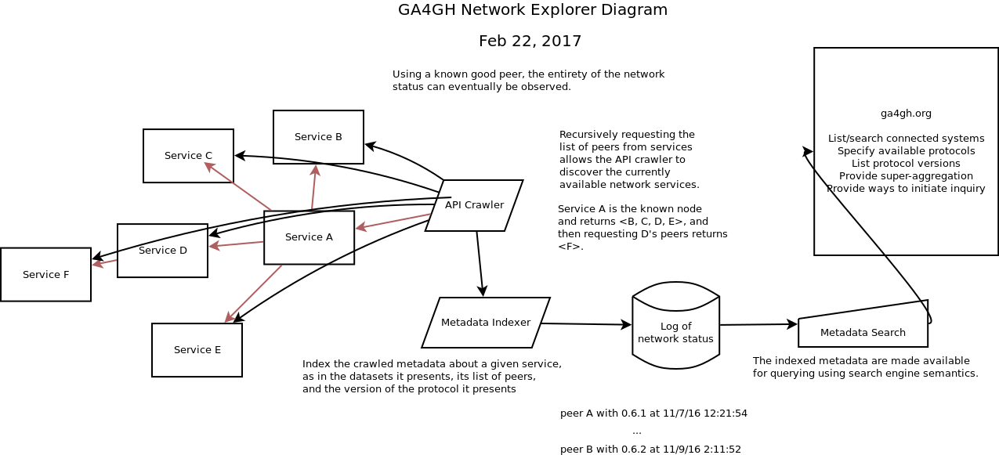
Proposal - Peer to Peer
David Steinberg
https://github.com/ga4gh/beacon-team/issues/75

Slide 52
Proposal - Peer to Peer
David Steinberg
https://github.com/ga4gh/beacon-team/issues/75

Slide 53
Thanks for your attention

Slide 54
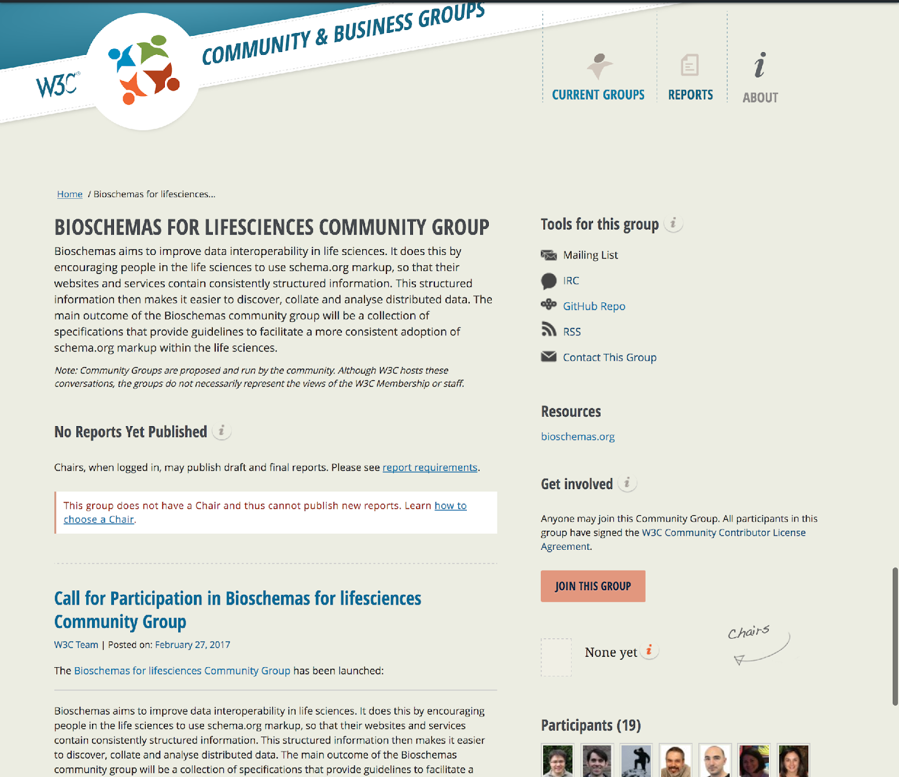
https://www.w3.org/community/bioschemas/

